Slide 1
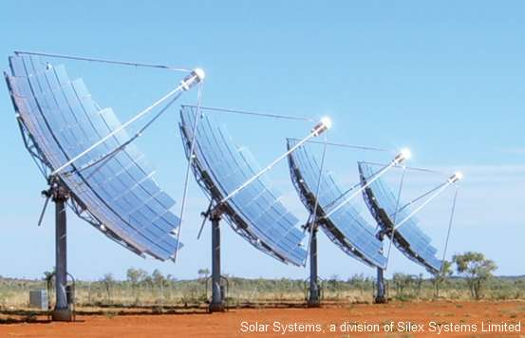
Metamorphic III-Sb for Si
Concentrated Photovoltaic systems
J.Tournet – PROMIS Midterm review - December 2016
Sup. Prof. E. Tournié and Dr. Y. Rouillard
Notes:
Good morning,
I am ESR number 10, Julie TOURNET, working under the supervision of Eric Tournié and Yves Rouillard at the University of Montpellier. My research deals with Metamorphic III-Antimonides for Silicon concentrated photovoltaic solar cells.

Slide 2
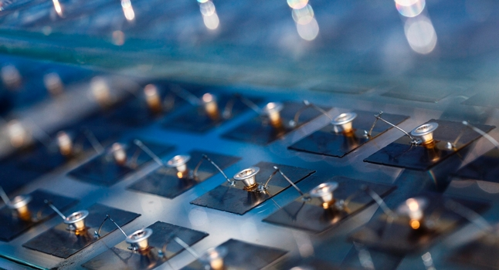
Outline
ESR presentation
Scientific context
Work
Impact
Soitec
CPV systems
1
Notes:
To walk you through this topic, I will start with a brief presentation of my background and situation within PROMIS. Then I will provide you with some context about our research. We will continue with the work achieved so far and what my aspirations are for and after this project.

Slide 3
Background
2007 -2010 Preparatory classes, Paris
Intensive program (Maths Physics, Engineering Sciences) preparing for the national competitive exam for the entry in engineering schools
2010-2012 : BSc. in telecommunication engineering, Télécom Bretagne, France
Optics, Networks, Electronics, Signal Processing, Computer Sciences, Economy and Human Sciences
2012 : Erasmus semester, Universitat Politécnica de Catalunya, Spain
Optoelectronics, Signal Processing, Astronomy, Remote sensing, Biometric systems
2012-2013 : 1-year internship (R&D engineer), University of Waterloo, Canada
Developing new interaction techniques between private and shared surfaces in collocated groupware
2
Notes:
First of all, let me introduce myself a bit more in details. I grew up on an island close to Madagascar called Reunion island. After high school, I moved to France to start a Bachelor degree in telecommunication engineering. During this time, I spent half a year in Barcelona where I specialized in telecommunication for spatial applications. After this degree, I moved to Canada and did a 1-year internship in Systems Design Engineering.

Slide 4
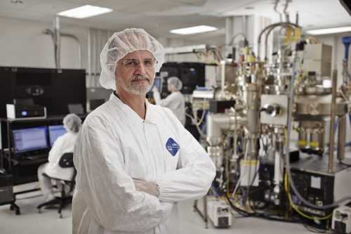
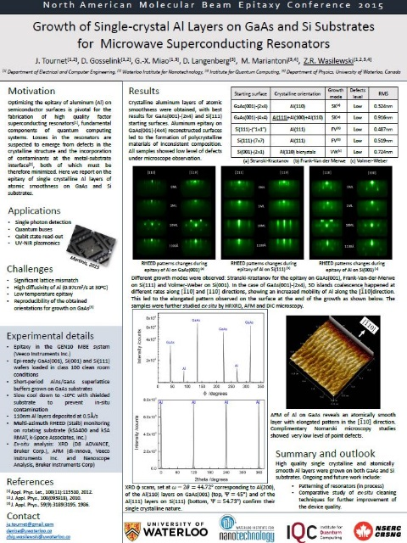
MASc. in Electrical & Computer Engineering /Nanotechnology
Setting up of the new MBE lab under the
supervision of Prof. Z.R.Wasilewski
2 year research project in collaboration with
the Institute for Quantum Computing
Coursework projects:
Simulation of microwave resonators
Writing of a review paper
Development of a band structure simulator
Publications:
Article in Superconductor Sc. and Tech. 29(6):064004 · June 2016
Posters at NAMBE, EUROMBE 2015
Presentation at CSSTC 2015
MASc. Thesis (Aug. 2015)
3
Notes:
Taking advantage of the creation of an institute for Nanotechnology, I pursued my Master’s degree in Canada with a full 2 year research project under the supervision of Professor Zbigniew Wasilewski. This experience was extremely enriching for me since, as I started the program, our Molecular Beam Epitaxy lab was a completely empty room. On top of my research project, I took classes in Nanotechnology Engineering and was a teaching assistant in Mathematics for which I received an award. I graduated with a GPA of 91%, published one article and had the chance to participate in three conferences.

Slide 5
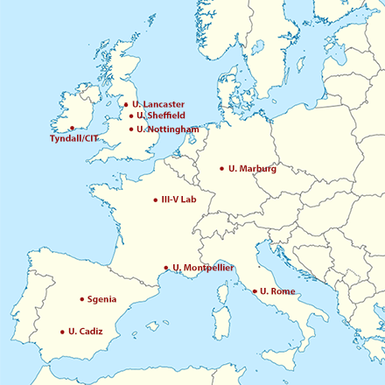
PROMIS ESR 10
Project:
Metamorphic III-Sb for Si concentrated
photovoltaic solar cells
World record efficiency: 46%
Within the network:
WP3: Materials for Energy
Close work with III-V Lab and UCA
4
Notes:
Within PROMIS, I belong to work package 3, focused on novel materials for energy. Our goal is to design and fabricate high efficiency solar cells. My goal in particular, is to make such high efficiency solar cells on cheap and readily available substrates like Silicon. I work very closely with III-V LAB in Paris and the University of Cadiz in Spain. Now, let’s have a closer look at this picture to set the research context.

Slide 6
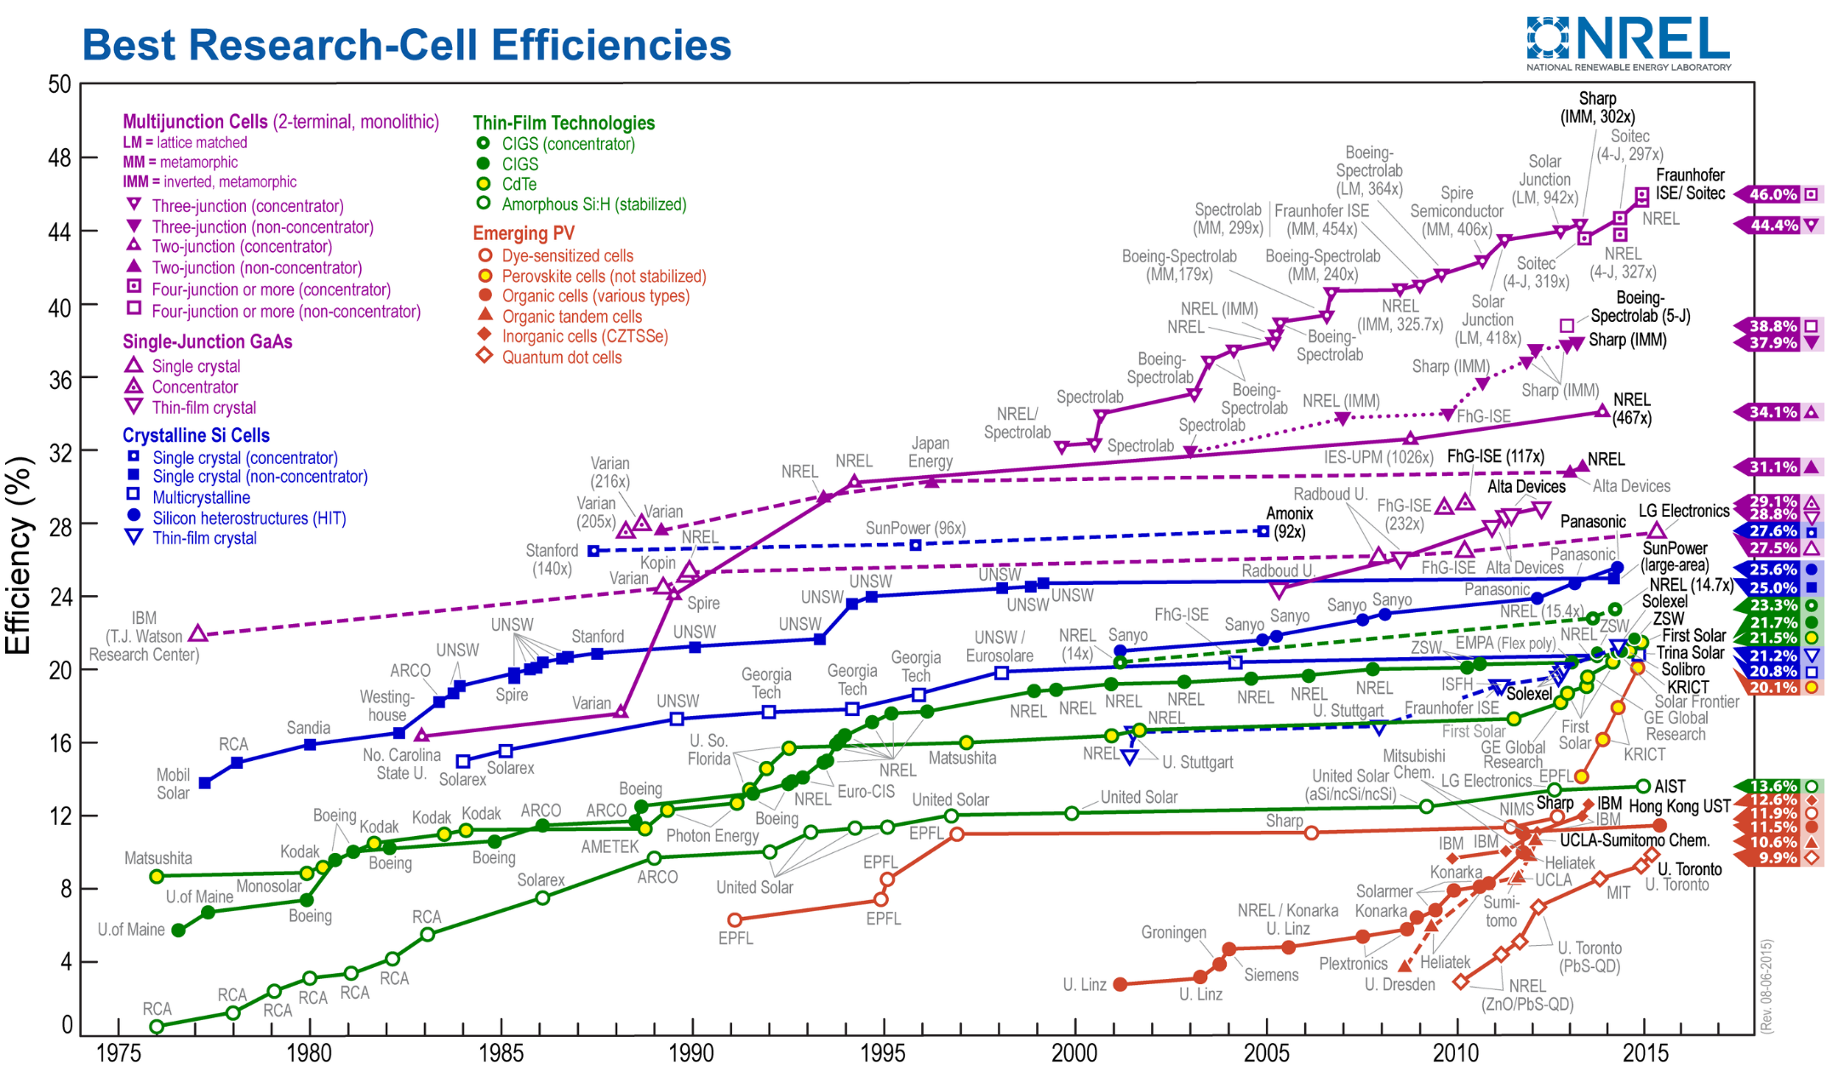
III-V multijunction solar cells
Notes:
This represents the evolution of record solar cells efficiency from 1975. The multijunction solar cells made with III-V materials we are interested in hold the top of the figure (the violet points there).

Slide 7
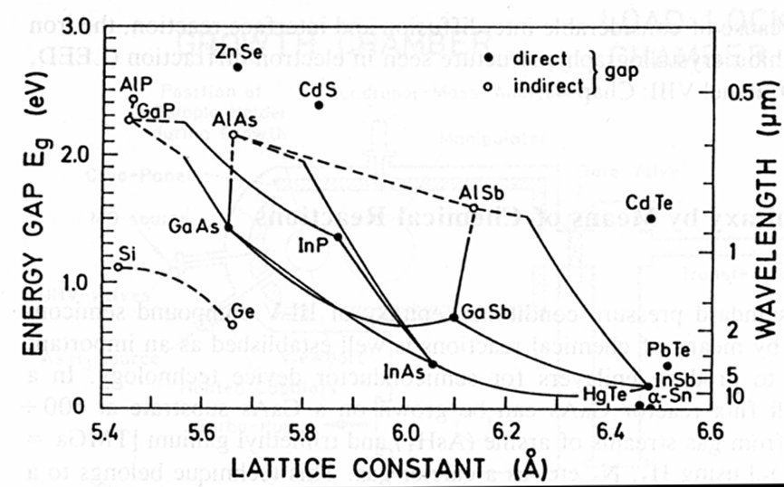
Interest in III-Sb compounds for Multi-Junction solar cells:
Adapted from: France et al,
MRS bulletin March 2016
4J
3J
2J
6
Notes:
Making a high efficiency solar cell with III-V materials is simple in theory. One can actually calculate what the ideal combination of materials is to maximize the efficiency. They are shown on this graph. For a 3J for example the bottom subcell should use any material laying on this green band, the middle this one and the top this one.

Slide 8
Interest in III-Sb compounds for Multi-Junction solar cells:
Adapted from: France et al,
MRS bulletin March 2016
4J
3J
2J
6
Notes:
Now this is theory. To actually fabricate devices of high quality, the best solution is to combine materials of similar structure. This means the selected materials should have lattice constants close to each other and fall around these ligns. Of course it is best to align these materials to an existing substrate which leads us to these four materials systems.

Slide 9
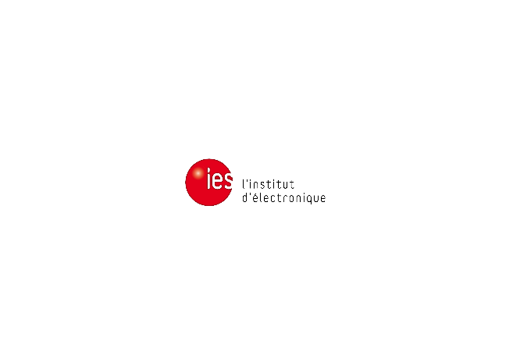
Interest in III-Sb compounds for Multi-Junction solar cells:
Adapted from: France et al,
MRS bulletin March 2016
4J
3J
2J
6
Notes:
Among these existing substrates, GaSb is of particular interest to us since it has been shown that it could be integrated onto Si. InP is also of interest since it could in theory reach the highest efficiencies.

Slide 10
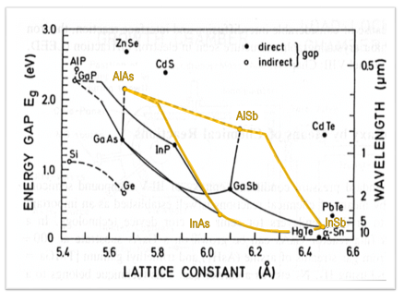
Desired structures:
Project 1:
AlInAsSb for solar cells
Cell type | Compo | E_{g} (V)
Tandem on GaSb | Al_{0.65}In_{0.35}As_{0.35}Sb_{0.65} | 1.45
Tandem on Si | Al_{0.75}In_{0.25}As_{0.19}Sb_{0.81} | 1.69
3J on GaSb Middle cell Top cell | Al_{0.53}In_{0.47}As_{0.45}Sb_{0.55} Al_{0.75}In_{0.25}As_{0.27}Sb_{0.73} | 1.21 1.68
Si
GaSb
No knowledge of the material,
need to study its properties first!
Notes:
My first project is then to fabricate and characterize a GaSb lattice-matched quaternary alloy to be the basis of our solar cell. AlInAsSb seems to be the best candidate since it offers quite a wide range of bandgap energies. However, there are only very few reports of this material in literature, likely due to an important miscibility gap. Hence we need to do a full study of the material to make sure it would perform well in our solar cells. In particular, the observed electronic properties turned out to be very different from what theory predicted. The integration of GaSb type material on Silicon is already well-known. So once we are able to tailor this quaternary to obtain the desired electronic properties, we will have a III-Sb cell on a cheap substrate.

Slide 11
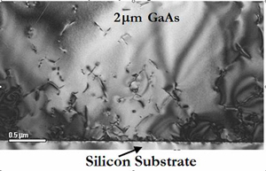
Project 2: InP templates onto Si
InP-based solar cells integrated onto Si.
Nucleation of an InP-lattice matched buffer on Si:
Lattice mismatch
Polar/non polar interface
Thermal expansion
Ga_{0,47}In_{0,53}As
Notes:
In the second project, we investigate the nucleation of InP lattice matched materials onto Silicon. This time we do not grow the solar cell but only provide a buffer between Si and InP so that III-V lab could overgrow their cells. This is very hard to do due to multiple reasons. First, there is an important lattice mismatch. Then we are trying to grow a polar material on a non polar material which can generate defects. Finally, the discrepancy in thermal expansion parameter is significant.

Slide 12
Project timeline
Year 1
Year 2
Year 3
Epitaxy of novel III-Sb materials
Device processing & characterization
Integration onto Silicon
Epitaxy & processing improvements
9
Notes:
Our timeline to achieve these goals is well-defined over the three years of the PhD.
My first year was dedicated to the epitaxy of the III-V alloys we considered using for the two projects. This implied simulation, epitaxy and material’s characterization. The current year, I focus more on the device processing and characterization on top of the integration of the materials onto Silicon. Feedbacks from III-V lab and the University of Cadiz will hopefully allow us to refine and improve the process during the final year to reach better efficiencies for our cells.

Slide 13
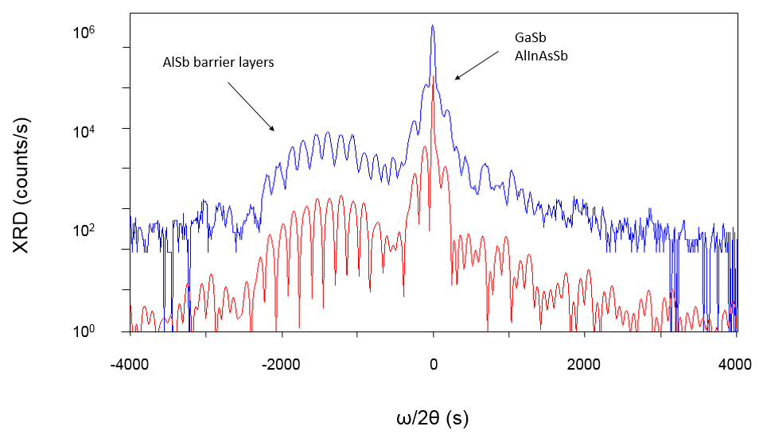
Outcome
Project 1: AlInAsSb cells
Successful and reproducible epitaxy of a novel material (AlInAsSb)
Study of the bandgap, comparison to literature models
Project 2: InP templates
Study of the impact of a GaSb buffer
Study of the AlSb nucleation layer
Publications and conferences
Posters at JNMO, ICMBE 2016
Proc. ICMBE 2016 (submitted)
Organization of two conferences
Outreach
Online article on shakepeers.org
HRXRD ω/2θ scan of A_{0.70}lIn_{0.30}As_{0.33}Sb_{0.67} lattice-matched to GaSb (blue, top) and its simulation (red, bottom).
10
Observed and calculated bandgap energies at 300K for AlInAsSb lattice-matched to GaSb for D_{AlInAsSb} = -2.5eV
Notes:
In terms of outcome, we achieved the goals set up for the first year. We were able to obtain good quality layers of a novel material we intend to use in solar cells in the near future. The material study attracted attention at the conferences we discussed it since this material could be used in a handful of other opto-electronic applications. Deeper analysis of the material structure is under way in collaboration with the University of Cadiz. Concerning the second project, we initiated the nucleation study and provided preliminary templates to III-V lab for overgrowth of the solar cell. Thanks to the recent feedback from UCA, we will be able to improve these templates in the coming months.

Slide 14
Secondment at III-V LAB (2weeks)
Introduction to MOVPE
Introduction to solar cell processing
Discovery of an industrial facility for epitaxy and processing
Secondment at Universidad de Cadiz (1month)
Introduction to sample’s preparation for TEM
Introduction to TEM observation and analysis
PROMIS workshops and summer school (3)
Introduction to nextnano and other simulation tools
Seminars from internationally-renowned experts
Training experience
Technical training at uMontpellier
MBE operation and maintenance
X-Ray Diffraction analysis
Photoluminescence spectroscopy
Wet and dry substrate preparation in clean room
11
Notes:
I benefited from technical training both in Montpellier and during my secondments. In Montpellier, I broadened my knowledge in Molecular Beam Epitaxy, X-Ray Diffraction and learned about photoluminescence spectroscopy. I was also trained to clean room operation, more specifically substrate preparation. In III-V Lab I was introduced to Metal Organic Vapor Phase Epitaxy and had a detailed presentation of clean room processing of solar cells. This will be very useful to me in the coming year. In the Universidad of Cadiz finally, I learned about sample preparation for Transmission Electron Microscope and its operation. This will allow smoother interactions between the growth and characterization teams in the project.

Slide 15
Aspirations
Gaining experience with epitaxy
Developing further MBE skills
Learning more about modelling and characterization
Discovering other techniques such as MOVPE (more common in industry)
Learning and being proficient with clean room processing
Fundamental for a career in opto-electronics
Opens the door to many application domains
Intercultural and interdisciplinary project management
Learning from various scientific backgrounds and cultures
Experiencing both academic and industrial environments
Meeting many actors in opto-electronics and renewable energy research
Resources and time management for large size projects
Scientific and science dissemination
12
Notes:
All these acquired skills fit in my career aspirations.
Those include learning and being proficient with both epitaxy and clean room processing which are fundamental to any work in opto-electronics. Learning about simulation and characterization is another opportunity PROMIS offers me through secondments and organized workshops. Finally, the intercultural and interdisciplinary aspect of the project is very important to me. I take full advantage of interacting with different working environments in different European countries. I would also like to mention the soft skills training sessions and the networking opportunities the PROMIS workshops bring us.
I think we can summarize this saying that PROMIS allows me to work, meet experts and gain knowledge in a domain I am passionate about which is renewable energies. For this I am deeply thankful to the European Commission and the leaders of this project.

Slide 16
Thank you for your attention
julie.tournet@umontpellier.fr
Notes:
Thank you for your attention. I will be pleased to answer any question.

